Slide 1
Infrastructure adds value to your portfolio
August 2024

Slide 2
Important Information
Important Information: This material has been delivered to you by Magellan Asset Management Limited ABN 31 120 593 946 AFS Licence No. 304 301 (‘Magellan’) and has been prepared for general information purposes only and must not be construed as investment advice or as an investment recommendation. This material does not take into account your investment objectives, financial situation or particular needs. This material does not constitute an offer or inducement to engage in an investment activity nor does it form part of any offer documentation, offer or invitation to purchase, sell or subscribe for interests in any type of investment product or service. You should obtain and consider the relevant Product Disclosure Statement (‘PDS’) and Target Market Determination (‘TMD’) and consider obtaining professional investment advice tailored to your specific circumstances before making a decision about whether to acquire, or continue to hold, the relevant financial product. A copy of the relevant PDS and TMD relating to a Magellan financial product may be obtained by calling +61 2 9235 4888 or by visiting www.magellangroup.com.au.
Past performance is not necessarily indicative of future results and no person guarantees the future performance of any financial product or service, the amount or timing of any return from it, that asset allocations will be met, that it will be able to implement its investment strategy or that its investment objectives will be achieved. This material may contain ‘forward-looking statements’. Actual events or results or the actual performance of a Magellan financial product or service may differ materially from those reflected or contemplated in such forward-looking statements.
This material may include data, research and other information from third party sources. Magellan makes no guarantee that such information is accurate, complete or timely and does not provide any warranties regarding results obtained from its use. This information is subject to change at any time and no person has any responsibility to update any of the information provided in this material. Statements contained in this material that are not historical facts are based on current expectations, estimates, projections, opinions and beliefs of Magellan or the third party responsible for making those statements (as relevant). Such statements involve known and unknown risks, uncertainties and other factors, and undue reliance should not be placed thereon. No representation or warranty is made with respect to the accuracy or completeness of any of the information contained in this material. Magellan will not be responsible or liable for any losses arising from your use or reliance upon any part of the information contained in this material.
Any third-party trademarks contained herein are the property of their respective owners and Magellan claims no ownership in, nor any affiliation with, such trademarks. Any third-party trademarks that appear in this material are used for information purposes and only to identify the company names or brands of their respective owners. No affiliation, sponsorship or endorsement should be inferred from the use of these trademarks. This material and the information contained within it may not be reproduced, or disclosed, in whole or in part, without the prior written consent of Magellan.
RP500

Slide 3

Why infrastructure adds to your portfolio value
Diversification
Infrastructure has different
risk and return characteristics
Fundamental performance
Financial performance of infrastructure
is structurally sound
Correlation is high in market correction
due to increase in real rates
Investment market experience
Correlation is low when correction is
due to other factors
IP205
Notes:
A rigorous assessment of investment risks and opportunities associated with climate change focuses on the likelihood of substitution, having regard to technological capability, cost competitiveness, and policy support.

Slide 4
Infrastructure provides diversification
Diversification aims to increase long-term performance by reducing investment risk
Owning investments that are not exposed to the same risks and that perform differently in similar markets avoids the risk of having all of your eggs in one basket
The benefits of diversification are threatened by behavioural impulses.
For the assets that are outperforming, it is easy to believe that this will persist.
For laggards it can be easy make the case that they will never deliver again.
Infrastructure is different to other asset classes and helps diversify an investment portfolio
Source: “How Diversification Works, and Why You Need It”, Forbes Advisor 30 July 2024 (https://www.forbes.com/advisor/investing/what-is-diversification/), “Diversification is not a free lunch” Firstlinks 29 November 2023 (https://www.firstlinks.com.au/diversification-not-free-lunch)
IP205

Slide 5
How is infrastructure different?
Key characteristics of infrastructure assets:
Infrastructure assets provide essential services – water, energy, transport
Infrastructure assets face limited competition and, consequently, are typically regulated
Services are essential
Revenue is reliable over the long-term
Limited competition + regulation
Earnings are predictable over the long-term
IP205

Slide 6

















The universe of infrastructure assets
INSTO & RETAIL
Approximately 350 stocks with a market capitalisation of more than US$4 trillion
Utilities
Transport
Social
Water Utilities
Airports
Hospitals
Gas Utilities
Toll Roads
Schools
Energy Transmission
and Distribution
Pipelines
Prisons
Power Generation
Communication
Power Retailers
Ports
Rail
Satellite
Master Limited
Partnerships
Car parks
RP079

Slide 7
How regulation works for regulated utilities
Step 1 | Capital employed – “Rated Base” x Cost of Capital = Net Profit After Tax
Step 2 | + Income Tax = Net Profit Before Tax + Interest Expense + Depreciation + Operating Expenditure & Cost of Energy = Revenue
Step 3 | ÷ Energy Volume = Energy Price
RP104

Slide 8
Regulation leads to stable financial performance
The earnings of US regulated utilities have been very stable over the long-term
Return On Equity from 2010 to 2023 for High Quality US Regulated Utilities
Source: Company accounts, Sentieo, Magellan Asset Management Limited analysis. Utility group includes Alliant Energy, Atmos Energy, Consolidated Edison, CMS Energy, Eversource, Southern Company, Evergy, WEC & Xcel Energy.
RP452

Slide 9
Infrastructure – nature of returns
Revenues and earnings reflect patronage growth
The revenue generated by infrastructure assets are a function of operating volume and price.
Revenue | = | Volume | X | Price
Toll Road Revenue | = | Number of cars | x | Average Toll
Airport Revenue | = | Number of passengers | x | Average Charge/Spend
SP001

Slide 10
Toll roads: highly price inelastic
Eastern Distributor Average Daily Traffic
Source: Transurban, Magellan analysis.
RP452

Slide 11
Toll road traffic volumes and earnings
Reliable earnings growth reflects patronage growth combined with inflation indexation
Source: Atlas Arteria, Magellan Asset Management Limited analysis.
RP500

Slide 12
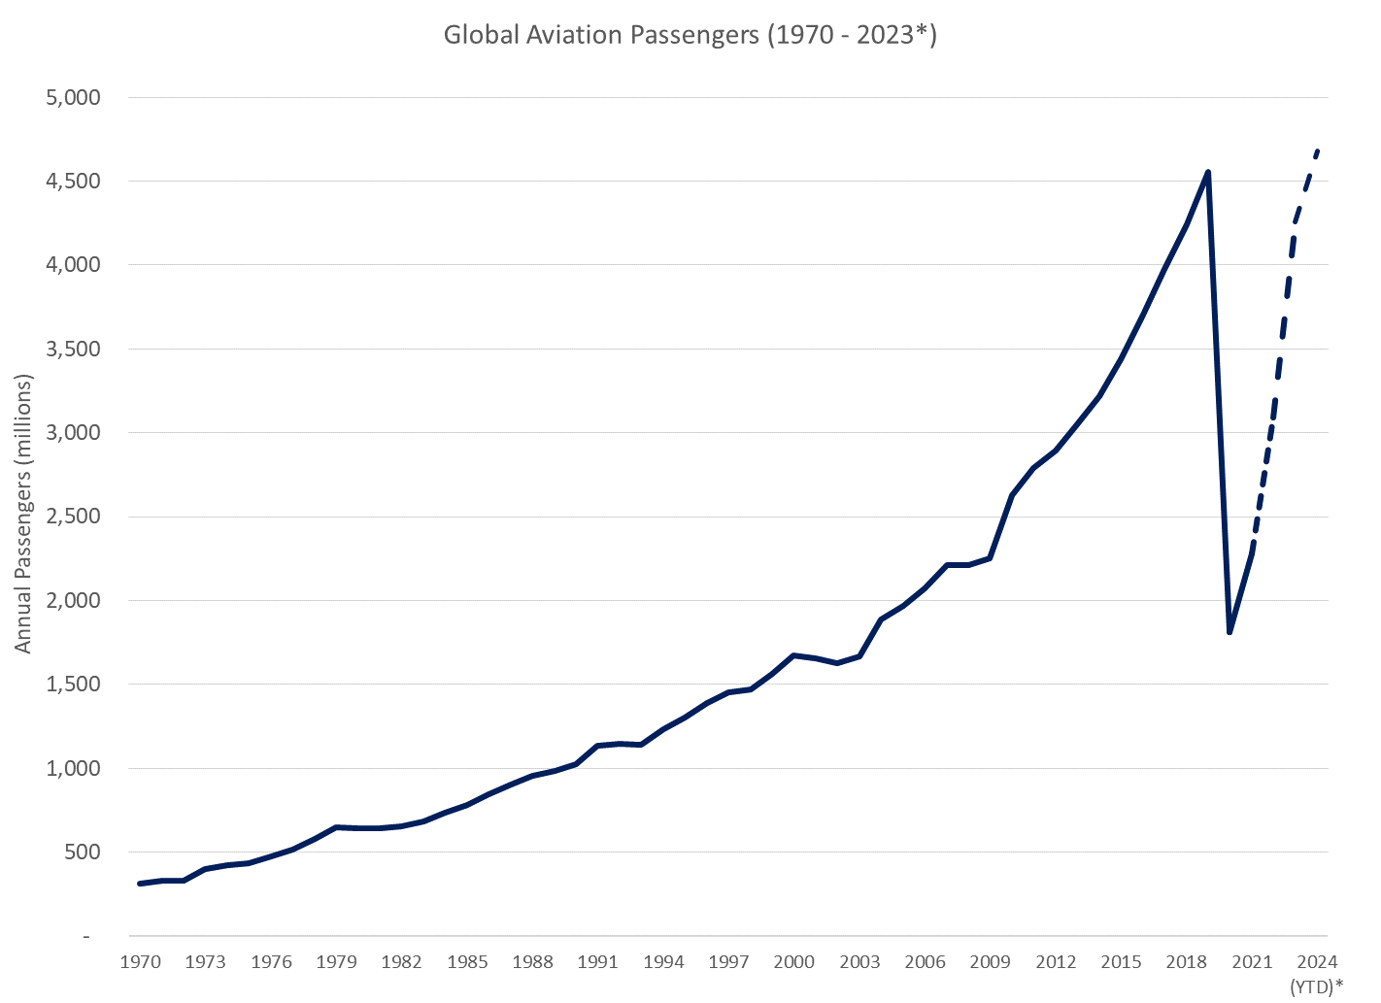
Aviation has shown resilient passenger growth
Global Aviation Passengers (1970 – 2023*)
Source: World Bank, 2022 and 2023 and 2024 YTD are based on IATA RPK data
DP155

Slide 13
How is infrastructure different?
Services are essential
Revenue is reliable over the long-term
Monopolistic markets + regulation
Earnings are predictable over the long-term
Infrastructure can be expected to reward patient investors with a long-term time frame
IP205

Slide 14
Infrastructure adds value to your portfolio

Slide 15
Infrastructure investment characteristics
Downside protection
Real Growth
Inflation protected cashflows
RP500
Notes:
[LINKING SLIDE]
GS has made case for infrastructure…
Downside protection = combine essential service delivey with monopoly characteristics.
Real growth = structural growth drivers linked to growing needs to society and economies
Inflation protection = underlying contracts CPI linked. (cashflows not share prices, we’ll come back to this)
…these are the fundamental characteristics. So how does it perform from a long-term market perspective.

Slide 16

Long term performance
Source: Bloomberg, Magellan
RP500
Notes:
This is long-term view (total return) on global equity markets. Typical viewed as a gold standard for growth assets

Slide 17
Infrastructure delivers real growth
Source: Bloomberg, Magellan
RP500
Notes:
This is overplayed with infrastructure….we’ve used a broader view of an benchmark that to be blunt we think is the best of a bad bunch. When we build portfoios we take a more conservative take, but this is probably a good proxy….
You can see very clearly that the benchmark has delivered against this real growth promise against global equities
However, you can see a divergence really kicks off in he post covid-era…we’ve been living this and want to share our experience

Slide 18
Downside protection
Source: Bloomberg, Magellan
RP500
Notes:
This is long-term view (total return) on global equity markets. Typical viewed as a gold standard for growth assets

Slide 19
Market drawdowns coupled with rising rates
Source: Bloomberg, Magellan
RP500
Notes:
These are the draw downs that have been characteristicsed by rising US 10 Y treasuries
In these environments draw downside capture is a lot worse for infratrucure
There was one other event during that period characterised by rising interests rates, however that was when trump was elected in 2016 and saw markets rally and rates go up on pro growth expectations.

Slide 20
Market drawdowns coupled with rising rates
Source: Bloomberg, Magellan
RP500
Notes:
These are the draw downs that have been characteristicsed by rising US 10 Y treasuries
In these environments draw downside capture is a lot worse for infratrucure
There was one other event during that period characterised by rising interests rates, however that was when trump was elected in 2016 and saw markets rally and rates go up on pro growth expectations.

Slide 21
Overview of drawdowns
Since 2010 there have been 18 events where markets have delivered returns of -5% or worse
Typically, these have lasted 2-3 months
Typically, these are 8%, with the worst at 35% (2020)
Source: Bloomberg, Magellan
RP500
Notes:
Since 2010 there have been 18 drawdowns of 5% or more.
They have typically been in drawdown for ~2-3 months.
Infrastructure has tended to outperform in that environment of declining rates, with a draw-down of 52%’.
HOWEVER
This hides an important characteristics
Rising rates make a big difference to the event

Slide 22
Overview of drawdowns
Since 2010 there have been 18 events where markets have delivered returns of -5% or worse
Typically, these have lasted 2-3 months
Typically, these are 8%, with the worst at 35% (2020)
Listed Core Infrastructure
Downside capture in drawdown |  | Performance end of drawdown
Average | 51.5% | Average | 103.9%
Average (in rising rates) | 79.5% | Average (rate led) | 98.7%
Average (non rate) | 43.5% | Average (non rate) | 105.4%
Source: Bloomberg, Magellan
RP500
Notes:
Since 2010 there have been 18 drawdowns of 5% or more.
They have typically been in drawdown for ~2-3 months.
Infrastructure has tended to outperform in that environment of declining rates, with a draw-down of 52%’.
HOWEVER
This hides an important characteristics
Rising rates make a big difference to the event

Slide 23
Case study 1: Double dip recession concerns
Source: Bloomberg, Magellan
RP500
Notes:
Many of you have lived these experiences, so a few case studies will make it clearer…
Here’s the double dip recession fears
Economic recovery concerns (April – August 2012)
Drawdown characterisation: economic outlook risk.
Major drivers: poor economic leading indicators in the US and China as well as concerns that Greece may not be willing to make cuts stipulated by bailout package.
Relative Drawdowns
MSCI - 12.21%
S&P Global Infrastructure - 7.06%
DJ, MCIF & MIF - not in drawdown.
Interest rates
Down 47 basis points
Fiscal cliff pandemonium (October - December 2012)
Drawdown characterisation: political risk.
Major drivers: intense period of debate surrounding the ability of the government to develop a plan to ensure the budget did not fall of a ‘fiscal cliff’ in January 2013 due to continued stalling of negotiations.
Relative Drawdowns
MSCI - 5.49%
S&P Global Infrastructure - 6.17%
DJ, MCIF & MIF - no drawdown
Treasuries
1.764 → 1.617%
15 basis points down
Total → down 62 basis points

Slide 24
Case study 2: Taper Tantrum
Source: Bloomberg, Magellan
RP500
Notes:
Many of you have lived these experiences, so a few case studies will make it clearer…
Here’s the sovereign debt crisis. You can see clearly the defensive qualities
Taper tantrum (May – July 2013)
Drawdown characterisation: monetary policy.
Major drivers: Bernanke’s congressional appearance indicating potential for tapering if strong economic growth continued led to market panic despite careful wording.
Relative Drawdowns
MSCI - 9.16%
S&P Global Infrastructure - 11.17%
DJ - 12.01%
MCIF - 9.65%
MIF - 9.24%
Treasuries
Up 70 basis points

Slide 25
Case study 3: Covid and inflation period
Source: Bloomberg, Magellan
RP500
Notes:
What we have seen in the aftershock of covid has been enormous inflation pressures. This has led to rising interest rates with US cash rates going up xbp and UST 10 Y going up xbps
You can see the effect on infra in this scenario
This has lead to interest rates dominating discussions and correlations. This si not unexpected given the assets, but its been a big effect. The underlying defensive qualities are still there and we note the outlook is different to the past….

Slide 26
Looking forward different environment
Source: Bloomberg, US Bureau of Labor Statistics
RP500
Notes:
Firstly, inflation has spiked and has rapidly come down to more ‘normal’ levels.
The escalation in rates is unlikely to repeat in this context…

Slide 27


Monetary conditions……
“Over the past two years, the economy has made considerable progress towards the Fed’s 2% inflation goal…”
Jay Powell, Chair, US Federal Reserve (Financial Times 10 July 2024, Wall Street Journal 15 July 2024)
“In the absence of any big new shocks, the ‘when-rather-than-if’ characterisation of prospective Bank Rate cuts still seems appropriate”
Huw Pill, Chief Economist, Bank of England
“Bank of England Governor Andrew Bailey told the Financial Times that “rate cuts were “in play” at future meetings of the BoE Monetary Policy Committee amid signs that tighter policy had quelled the risk of a wage-price spiral…”
(Source: Financial Times 22 March 2024)
ECB cuts interest rates for first time in 5 years on 7 June 2024
Lagarde said the ECB had decided to cut “because overall our confidence in the path ahead . . . has been increasing [in] the past few months”, adding that the “reliability of our forecasts” had risen markedly in recent quarters.
(source: Financial Times 7 June 2024)
ECB president Christine Lagarde said there was a “strong likelihood” the decision marked the beginning of “dialling back” rates from their all-time high
(source: Financial Times 7 June 2024)
IP205
Notes:
And we’re see central banks either cutting or preparing to cut….

Slide 28
Further reading
“How diversification works, and why you need it”,
Rob Berger and Benjamin Curry, 30 July 2024, Forbes Advisor
LINK: https://www.forbes.com/advisor/investing/what-is-diversification/
“The value of diversification”,
Paolo Sodini and Luis Viceira, Harvard Business School Working Paper, No 17-085, March 2017
LINK: https://scholar.harvard.edu/files/lviceira/files/ap7_annual_report-ps_and_lv-2020-01-29.pdf
“The rationale behind Magellan’s definition of the investable infrastructure universe”
LINK: https://www.magellangroup.com.au/sites/magellan/assets/File/MAM%20-%20Infrastructure%20strategy%20rationale%20-%20MC431_FINAL.pdf
Transcript of Chair Powell’s press conference, 31 July 2024, US Federal Reserve
LINK: https://www.federalreserve.gov/mediacenter/files/fomcpresconf20240731.pdf
RP500

Slide 29
Infrastructure adds value to your portfolio

