Slide 1
Dominance or Diversify? Finding the sweet spot in a narrow market.
Zurich Investments
August 2024

Slide 2
General Advice Warning
This presentation contains general advice only which has been prepared without taking account the personal objectives, financial situation or needs of any person.
Unless otherwise indicated the information in this presentation dated, August 2024, is given in good faith and has been derived from sources believed to be accurate as at this date and is subject to change. However, it should not be considered as a comprehensive statement on, or study of, any matter and should not be relied on as such.
Neither Zurich Investments nor any of its related entities, their employees or directors, give any warranty of reliability or accuracy and to the fullest extent possible under law, accept no responsibility arising in any way whatsoever including by reason of negligence for errors or omissions.
These Funds are not available for investment to US residents, US citizens or US nationals. It is not to be marketed, promoted and must not be offered in any way to US citizens, US nationals or US residents. The Fund is not regulated by the SEC under any U.S securities or US Insurance laws.
Past performance is not a reliable indicator of future performance.
We highly recommend you consider the relevant Fund PDS when making financial decisions about these funds. A copy of the PDS for each product is available from financial advisers or by contacting Zurich Investments. Zurich Investment Management Limited ABN 56 063 278 400 AFSL 232511, 118 Mount Street North Sydney NSW 2060 (Zurich Investments).
GIIN XYY9MQ.00000.SP.036 Phone 1800 500 655
PNOE-022035-2024

Slide 3
Table of Contents
01 | Market Drivers
02 | Growth Opportunities

Slide 4
Global Equity Market Overview
After a long period of tight conditions, the U.S. labour market is now normalizing. Unemployment is elevated compared to a year ago, and continuing claims for unemployment benefits recently hit their highest point in more than two years. Anecdotal weakness in consumer spending, with companies reporting that many high-income customers are trading down to less expensive products and that less-affluent consumers are gravitating to private-label offerings.
Recent US CPI readings have been better than expected, with market pricing now fully reflecting two Fed rate cuts this year, starting in September. A softening labour market should also lead to lower wage increases.
Inflation has eased notably in the eurozone and the U.K., more so than in the U.S., but reaching the official 2% target may take more time. Nevertheless, the slowdown was sufficient for the European Central Bank (ECB) to cut interest rates in June for the first time since 2019.
Earnings growth could be poised to broaden. A wider range of companies could post strong earnings growth in the second half of 2024. Many technology-related businesses have tough year-over-year profit growth comparisons to beat, while sectors that struggled in 2023 have relatively easier hurdles to clear. As a result, we may see the Magnificent Seven come back to the pack. According to earnings growth forecasts, the rest of the S&P 500 Index will overtake the Magnificent Seven in the fourth quarter. In turn, market performance could become more widely distributed as a broader range of companies delivers stronger profit growth.
The real estate slump remains a headwind for China. The real estate market is the key sentiment driver for industrial and consumer demand in China. Despite recent policy changes, China’s housing market continues to face downward price pressures from excess supply and is creating headwinds for China-based businesses and companies selling into the country.

Slide 5
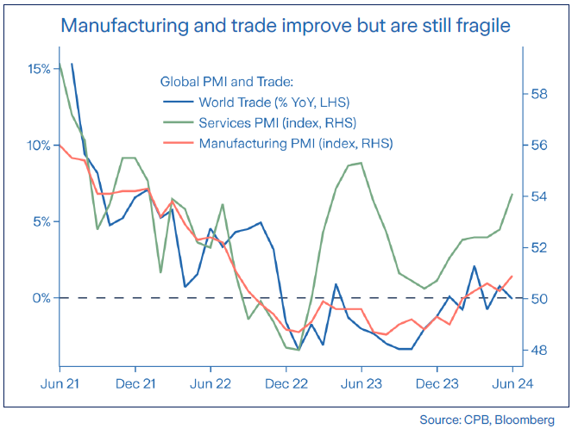
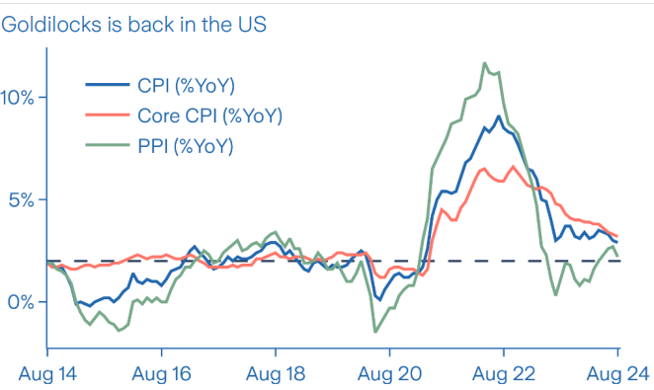
Global growth close to trend, as manufacturing recovery broadens
Inflation targets within reach, though last mile is proving challenging
Source: Bloomberg

Slide 6
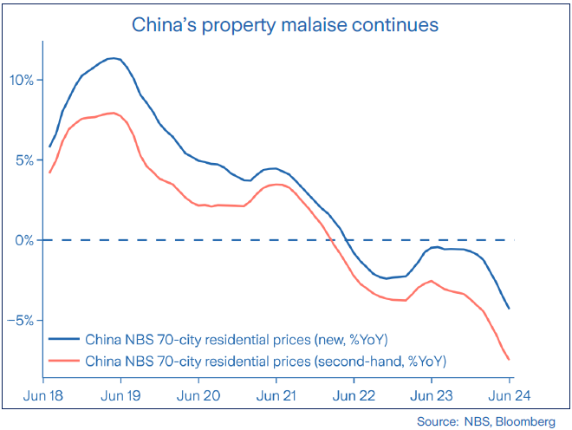
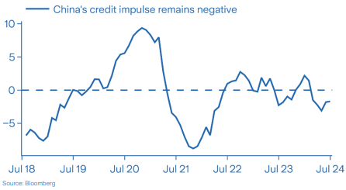
Ailing property market remains China’s Achilles heel
And weak credit demand from both corporate and household sector

Slide 7
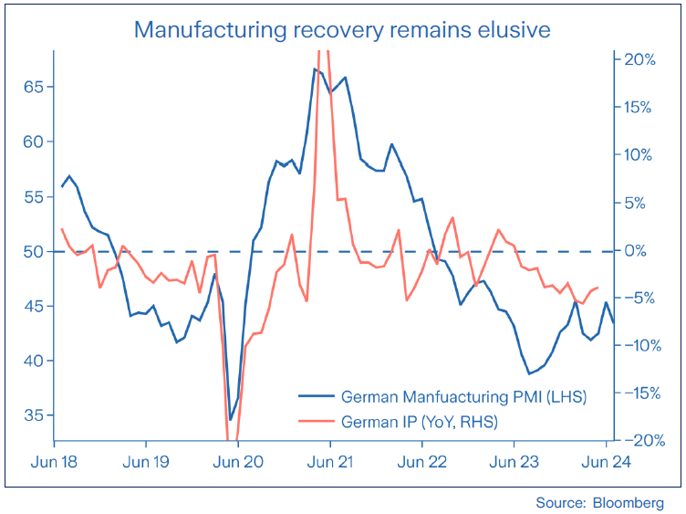
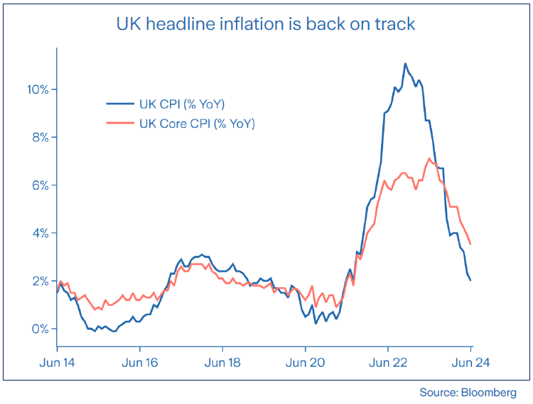
ECB’s first cut delivered, as growth momentum stalls
UK headline inflation falls back to the BoE’s target of 2%
Notes:
.

Slide 8
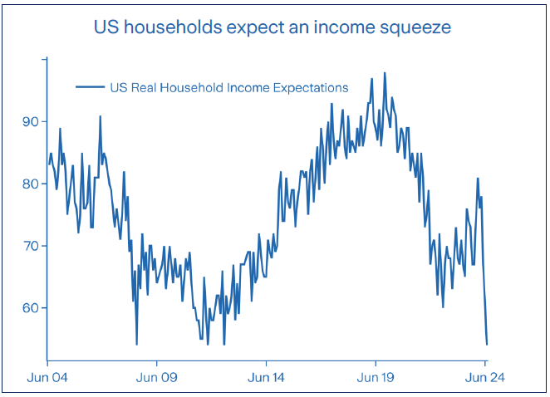
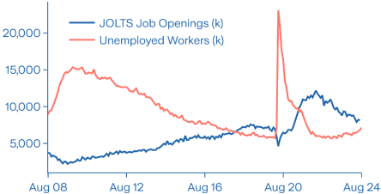
US labour market is becoming more balanced
Deteriorating income expectations could weigh on consumer spending
“Promote maximum employment”
Source: Bloomberg
Source: University of Michigan

Slide 9
Bond yields roll over on fading price pressure and modest growth outlook
US stock market re-convergence?
Source: Bloomberg; Data is from 30 June 2023 to 22 August 2024. Indices in USD.

Slide 10
Market Concentration
Data from: 31/01/2005 to 28/06/2024.
Source: American Century Investments

Slide 11
Dominance
The Magnificent–7 have massively outperformed
Source: Bloomberg; Magnificent & is the Bloomberg Magnificent 7 Total Return Index which is an equal-weighted equity benchmark consisting of Apple, Microsoft, Alphabet, Amazon, Nvidia, Tesla, Meta. Data is from 30 December 2022 to 22 August 2024. Both indices in USD. Past performance is not a guide to future performance and may not be repeated.

Slide 12
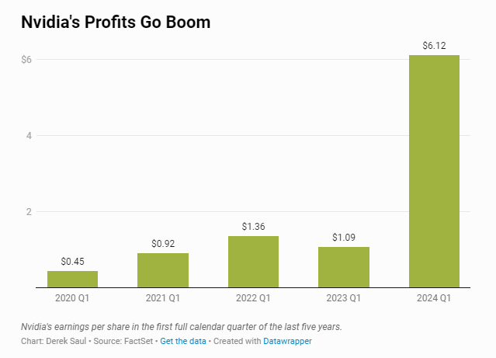
Dominance
Source: Forbes

Slide 13
Divergence
Performance of the Magnificent 7 relative to the S&P500
Source: Bloomberg; data from 29 December 2023 to 22 August 2024. Past performance is not a guide to future performance and may not be repeated.

Slide 14
S&P 500 Index return minus S&P500 Equal-Weighted return
Equal Weight S&P 500 Outperforms
Source: Bloomberg; data by calendar tear since 1990. Data for 2024 is to 22 August 2024.

Slide 15
Investing With a Well-Defined Bottom-Up Growth Philosophy
We believe that accelerating, sustainable growth in revenues and earnings, driven by an inflection in business fundamentals, results in stock price outperformance.
We believe the direction of earnings growth is a more powerful predictor of stock price performance than the absolute level of growth.
We focus on inflection points in companies’ fundamentals because we believe markets are inefficient at identifying these changes
Our process is designed to uncover stocks that outperform as earnings growth accelerates, market expectations rise and multiples expand
Growth over time
Growth over time
Source: American Century Investments

Slide 16
Four Factors of Stock Selection
I
S
G
V
VALUATION / RISK-REWARD
INFLECTION
SUSTAINABILITY
EARNINGS GAP
Is there a change in fundamentals?
What is driving the change?
Is it early in company’s growth cycle?
Is the inflection in fundamentals sustainable?
What are the key risks to the durability of growth?
Does consensus fully reflect acceleration in fundamentals?
Are out-year consensus estimates beatable?
Is valuation reasonable given the growth opportunity?
What is downside risk?
We believe well-defined criteria leads to focused, disciplined, and repeatable stock selection
Source: American Century Investments.

Slide 17
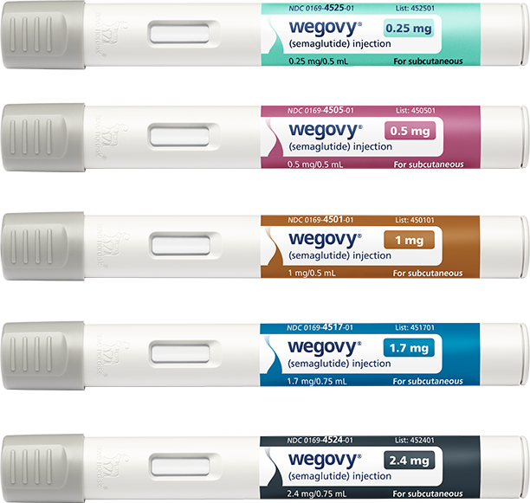
Novo Nordisk
INFLECTION – Wegovy (Novo Nordisk's obesity drug) supply issues have been resolved so we should start to see it ramp up.
SUSTAINABILITY – Novo's key therapeutic areas of diabetes (particularly the GLP-1 class) and obesity continue to have a good long-term outlook for growth with a growing prevalent population.
GAP – Consensus is undervaluing their obesity segment and insulin products, which we believe there is room for upside to peak sales.
VALUATION – The stock is higher than where it was a few years ago, but we believe it doesn't account for strong obesity and weekly insulin data the company has released.
Novo Nordisk A/S is a global healthcare company that develops, manufactures, and markets pharmaceutical products. It operates through the Diabetes and Obesity Care, and Biopharm segments. The company was founded in 1925 and is headquartered in Bagsværd, Denmark.
Source: Novo Nordisk, American Century Investments. ,
PNOE-019934-2023

Slide 18
Novo Nordisk A/S Class B – Relative Earnings Revisions and Stock Price Return
Novo Nordisk A/S Class B
Relative EPS Growth and Relative Cumulative Total Return
Novo Nordisk A/S Sponsored ADR Class B Stock Cumulative Total Return relative to the MSCI ACWI index (LHS)
Novo Nordisk A.S Sponsored ADR Class B Absolute EPS Revisions (RHS)
Source: FactSet. Past Performance is no guarantee of future results. Data from 06/12/2022 to 28/06/2024. Data in USD. Source: FactSet. References to specific securities are for illustrative purposes only, and are not intended as recommendations to purchase or sell securities. Opinions and estimates offered constitute our judgment and along with other portfolio data, are subject to change without notice.

Slide 19
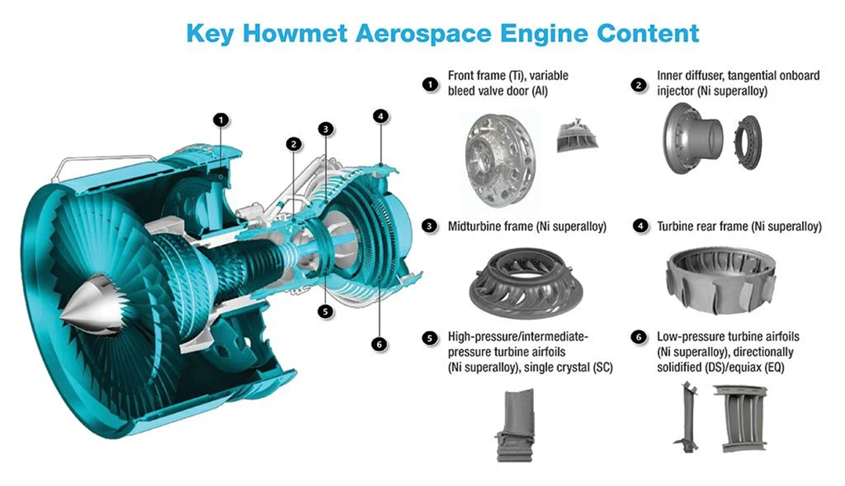
Howmet Aerospace Inc
Howmet Aerospace Inc. (HWM-US)
INFLECTION – We believe revenue and earnings growth are at the early stage of inflecting positively driven by rising production at Boeing Co. and Airbus, which in turn are benefiting from a recovery of demand as global travel recovers from the pandemic. Howmet Aerospace Inc. also levered to widebody models, which is seeing incrementally stronger demand growth.
SUSTAINABILITY – The backlog for both Boeing and Airbus are lengthy, which we estimate to be between nine to eleven years based on 2022 production rates. Howmet’s casting and foregoing operations have high barriers to entry and content on existing model platforms, which have already been allocated for the life of those programs.
GAP – Our estimates are above consensus estimates on expectations that the company will continue to realize rising margins in part from product mix. We also expect the company to sustain its share repurchasing program.
VALUATION – Shares trade at a discount to its aerospace supplier peers.
Howmet Aerospace, Inc. engages in provision of engineered solutions for the aerospace and transportation industries. It operates through the following segments: Engine Products, Fastening Systems, Engineered Structures, and Forged Wheels. The company was founded in 1888 and is headquartered in Pittsburgh, PA.
Source: FactSet. References to specific securities are for illustrative purposes only and are not intended as recommendations to purchase or sell securities. Opinions and estimates offered constitute our judgment and along with other portfolio data, are subject to change without notice. Past performance is no guarantee of future results.

Slide 20
Howmet’s Products
Critical for aerospace growth considering trends in new engines
Leading positions across all product lines
Circa 90% of revenue under long-term agreements
Differentiated technologies and solutions to continue driving content gains

Slide 21
Howmet Aerospace Inc. – Relative Earnings Revisions and Stock Price Return
Howmet Aerospace Inc.
Relative EPS Growth and Relative Cumulative Total Return
Howmet Aerospace Inc. Cumulative Total Return relative to the MSCI ACWI index (LHS)
Data from 01/05/2023 to 28/03/2024. Data in USD. Source: FactSet. References to specific securities are for illustrative purposes only, and are not intended as recommendations to purchase or sell securities. Opinions and estimates offered constitute our judgment and along with other portfolio data, are subject to change without notice. Past Performance is no guarantee of future results.
Howmet Aerospace Inc. Absolute EPS Revisions (RHS)

Slide 22
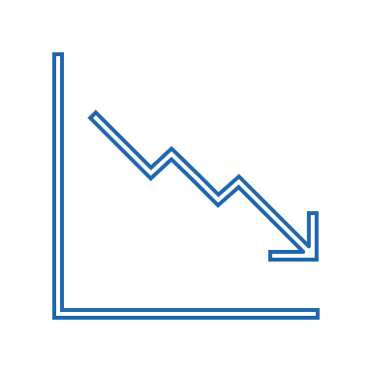
Global Growth: Diverse Bottom-Up Opportunities
We believe that a key benefit of our investment approach is the ability to identify businesses with a diverse set of growth drivers. We think these drivers are highly sustainable and complement other idiosyncratic reasons which define our full thesis.
Decarbonization
Increasing capital spending tied to decarbonizations and the energy transition
Nearshoring
Accelerating growth tied to nearshoring and infrastructure spending
NXP Semiconductors, Williams Company
Canadian Pacific, Prologis
New Products and Services
Revenue and profit growth driven by the commercialization of new products and services
Artificial Intelligence
Increasing spending tied to AI and select beneficiaries of AI adoption
Novo Nordisk
Microsoft, Amazon, NVIDIA
Opportunities in developing markets
Rising penetration of financial services
Outsourcing Trends
Driving operational efficiencies through outsourcing of functions
Bank Central Asia
Icon PLC, Danaher Corp
Civil Aerospace
Select opportunities tied to cyclical recovery in commercial aerospace
Howmet Aerospace, TransDigm Group Inc.
Data as of 30/06/2024. References to specific securities are for illustrative purposes only and are not intended as recommendations to purchase or sell securities. Opinions and estimates offered constitute our judgment and along with other portfolio data, are subject to change without notice.

Slide 23
Summary
Dominance & Diversify
The Magnificent 7 dominance may be losing steam
Stellar earnings growth (again, Nvidia) has supported most of the M7, though some have fallen away YTD
While market dominance exists, the opportunity to diversify into a broad range of growth stocks remains
A broadening out of market returns could see the rest of the world play ‘catch-up’
As the market focuses on a select few, market opportunities exist in areas such as Health Care, Cyclicals and nearshoring, amongst others
A well-diversified portfolio enables investors to manage the risks of increasing equity market leadership and remain focused on company-specific growth trends

Slide 24
zurich.com.au/globalgrowth
Zurich Investments
Notes:
.

