Slide 1
Exploring income-generating investments
How to create a diversified income stream and optimise portfolio yield
Madison Investment Specialist Forum
August 2024

Slide 2
Disclaimer
This document is issued by Global X Management (AUS) Limited (“Global X”) (Australian Financial Services Licence Number 466778, ACN 150 433 828) and Global X is solely responsible for its issue. This document may not be reproduced, distributed or published by any recipient for any purpose. Under no circumstances is this document to be used or considered as an offer to sell, or a solicitation of an offer to buy, any securities, investments or other financial instruments. Offers of interests in any retail product will only be made in, or accompanied by, a Product Disclosure Statement (PDS) which is available at www.globalxetfs.com.au. In respect of each retail product, Global X has prepared a target market determination (TMD) which describes the type of customers who the relevant retail product is likely to be appropriate for. The TMD also specifies distribution conditions and restrictions that will help ensure the relevant product is likely to reach customers in the target market. Each TMD is available at www.globalxetfs.com.au.
The information provided in this document is general in nature only and does not take into account your personal objectives, financial situations or needs. Before acting on any information in this document, you should consider the appropriateness of the information having regard to your objectives, financial situation or needs and consider seeking independent financial, legal, tax and other relevant advice having regard to your particular circumstances. Any investment decision should only be made after obtaining and considering the relevant PDS and TMD.
This document has been prepared by Global X from sources which Global X believes to be correct. However, none of Global X, the group of companies which Mirae Asset Global Investments Co., Ltd is the parent or their related entities, nor any of their respective directors, employees or agents make any representation or warranty as to, or assume any responsibility for the accuracy or completeness of, or any errors or omissions in, any information or statement of opinion contained in this document or in any accompanying, previous or subsequent material or presentation. To the maximum extent permitted by law, Global X and each of those persons disclaim all any responsibility or liability for any loss or damage which may be suffered by any person relying upon any information contained in, or any omissions from, this document.
Investments in any product issued by Global X are subject to investment risk, including possible delays in repayment and loss of income and principal invested. None of Global X, the group of companies of which Mirae Asset Global Investments Co., Ltd is the parent, or their related entities, nor any respective directors, employees or agents guarantees the performance of any products issued by Global X or the repayment of capital or any particular rate of return therefrom.
The value or return of an investment will fluctuate and an investor may lose some or all of their investment. All fees and costs are inclusive of GST and net of any applicable input tax credits and reduced input tax credits, and are shown without any other adjustment in relation to any tax deduction available to Global X. Past performance is not a reliable indicator of future performance. Diversification does not ensure a profit nor guarantee against a loss. Brokerage commissions will reduce returns. This material represents an assessment of the market environment at a specific point in time and is not intended to be a forecast of future events, or a guarantee of future results. Forecasts are not guaranteed and undue reliance should not be placed on them. This information is based on views held by Global X as at 17/08/2024.

Slide 3
Who are we?
Beyond Ordinary Solutions

Slide 4
~US$84bn
93 ETF Listings
42 ETF Listings
40 ETF Listings
44 ETF Listings
In Brazil & Colombia
43 ETF Listings
40 ETF Listings
125 ETF Listings

Slide 5
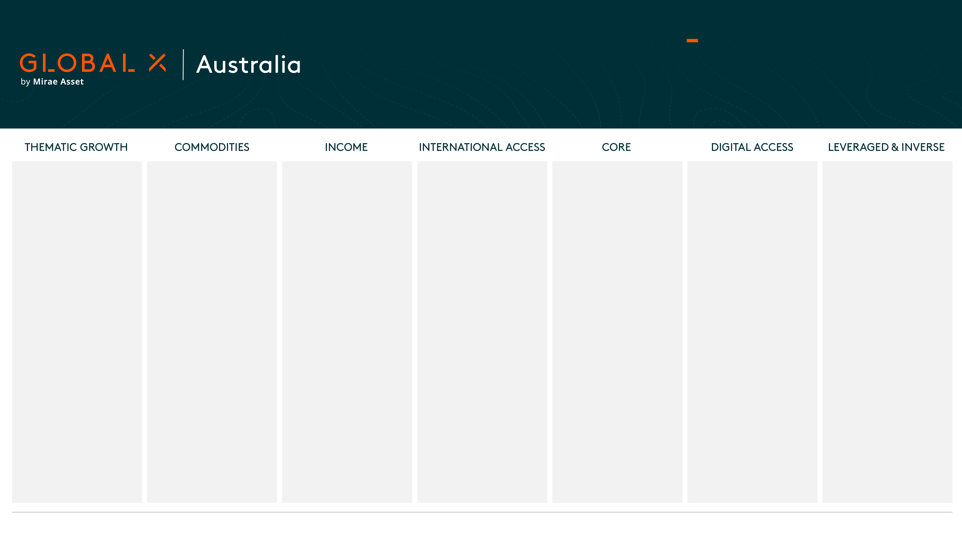
AU$7.9bn+
45+ employees based in
Sydney, Melbourne & Brisbane
Across 40 Strategies¹
DISRUPTIVE TECHNOLOGY
ACDC | Global X Battery Tech & Lithium ETF
BUGG | Global X Cybersecurity ETF
FTEC | Global X Fintech & Blockchain ETF
GXAI | Global X Artificial Intelligence ETF
ROBO | Global X ROBO Global Robotics & Automation ETF
SEMI | Global Semiconductor ETF
TECH | Global X Morningstar Global Technology ETF
MULTI-THEME
FANG | Global X FANG+ ETF
FHNG | Global X FANG+ (Currency Hedged) ETF
PEOPLE & DEMOGRAPHICS
CURE | Global X S&P Biotech ETF
PHYSICAL ENVIRONMENT & INFASTRUCTURE
HGEN | Global X Hydrogen ETF
PAVE | Global X US Infrastructure Development ETF
MINERS
ATOM | Global X Uranium ETF
GMTL | Global X Green Metal Miners ETF
WIRE | Global X Copper Miners ETF
PHYSICAL
ETPMAG | Global X FANG+ ETF | Global X Physical Silver
ETPMPD |  | Global X Physical Palladium
ETPMPM |  | Global X Physical Precious Metals Basket
ETPMPT |  | Global X Physical Platinum
GOLD |  | Global X Physical Gold
GXLD |  | Global X Gold Bullion ETF
SYNTHETIC
BCOM | Global X Bloomberg Commodity ETF (Synthetic)
GCO2 | Global X Global Carbon ETF (Synthetic)
COVERED CALL
AYLD | Global X S&P/ASX 200 Covered Call ETF
QYLD | Global X Nasdaq 100 Covered Call ETF
UYLD | Global X S&P 500 Covered Call ETF
DIVIDEND
ZYAU | Global X S&P/ASX 200 High Dividend ETF
ZYUS | Global X S&P 500 High Yield Low Volatility ETF
FIXED INCOME
BANK | Global X Australian Bank Credit ETF
USHY | Global X USD High Yield Bond ETF (Currency Hedged)
USIG | Global X USD Corporate Bond ETF (Currency Hedged)
USTB | Global X US Treasury Bond ETF (Currency Hedged)
REGIONAL
ESTX | Global X EURO STOXX 50® ETF
SINGLE COUNTRY
NDIA | Global X India Nifty 50 ETF
CORE
U100 | Global X US 100 ETF
OZXX | Global X Australia ex Financials & Resources ETF
DIGITAL ASSETS
EBTC | Global X 21Shares Bitcoin ETF
EETH | Global X 21Shares Ethereum ETF
LEVERAGED & INVERSE
LNAS | Global X Ultra Long Nasdaq 100 Hedge Fund
SNAS | Global X Ultra Short Nasdaq 100 Hedge Fund
© Global X ETFs 2024 | globalxetfs.com.au
¹ As of August 2024

Slide 6



Agenda
1
Challenging Economic Backdrop
2
How to Optimise Your Portfolio for Income
3
Income Opportunities with ETFs

Slide 7
Challenging Economic Backdrop

Slide 8
Cost of living pressures continue to impact households
With wage growth failing to match inflation over the past couple of years, investors may explore avenues to supplement their income.

Slide 9
Australians are living longer, but can we afford to?
With the average Australian now living into their mid-80s, ensuring financial stability during the golden years of retirement is a crucial focus area.
Sources: Australian Bureau of Statistics, The Association of Superannuation Funds of Australia (ASFA), Services Australia.

Slide 10
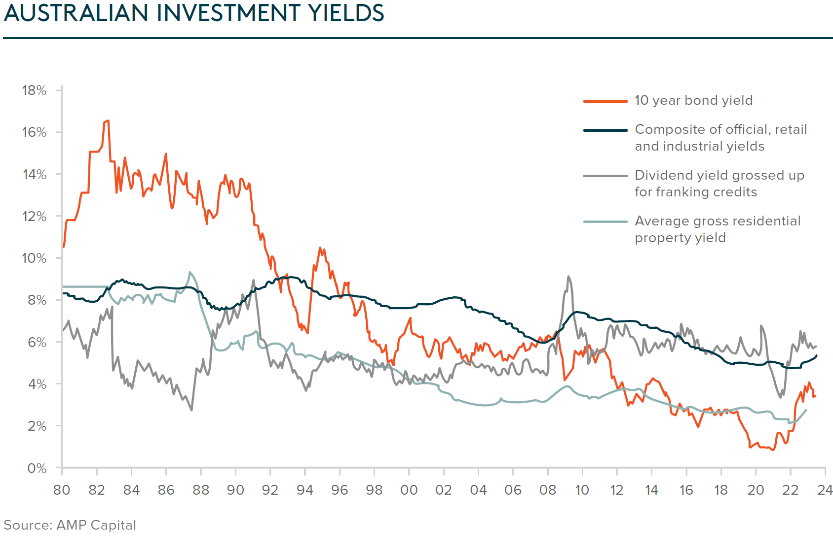
Australian investors desire a sustainable income stream but cannot rely on the 1980’s yield nirvana
One-third of investors are prioritising income generation, prompting consideration of asset classes beyond traditional options like property and term deposits.
Source: ASX Investor Study 2023

Slide 11
How to Optimise Your Portfolio for Income

Slide 12
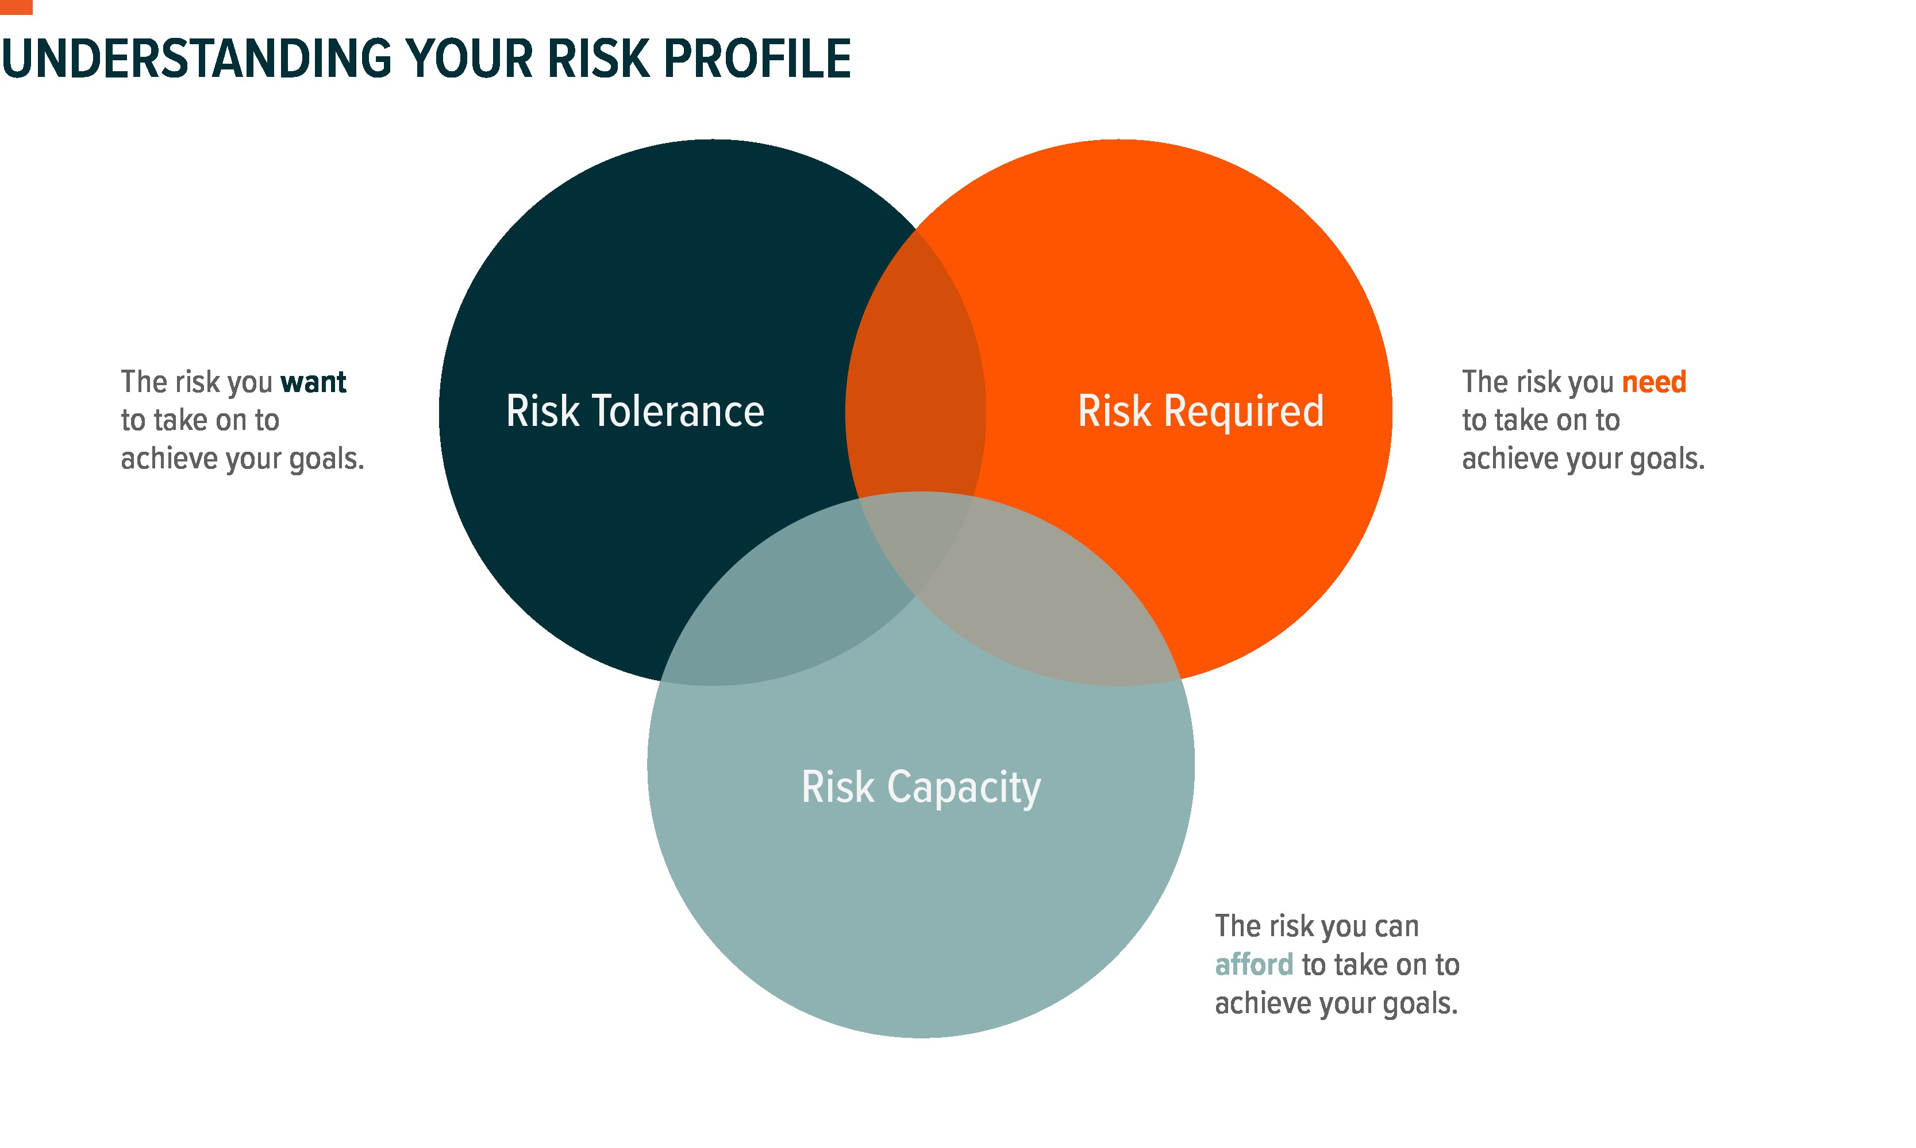
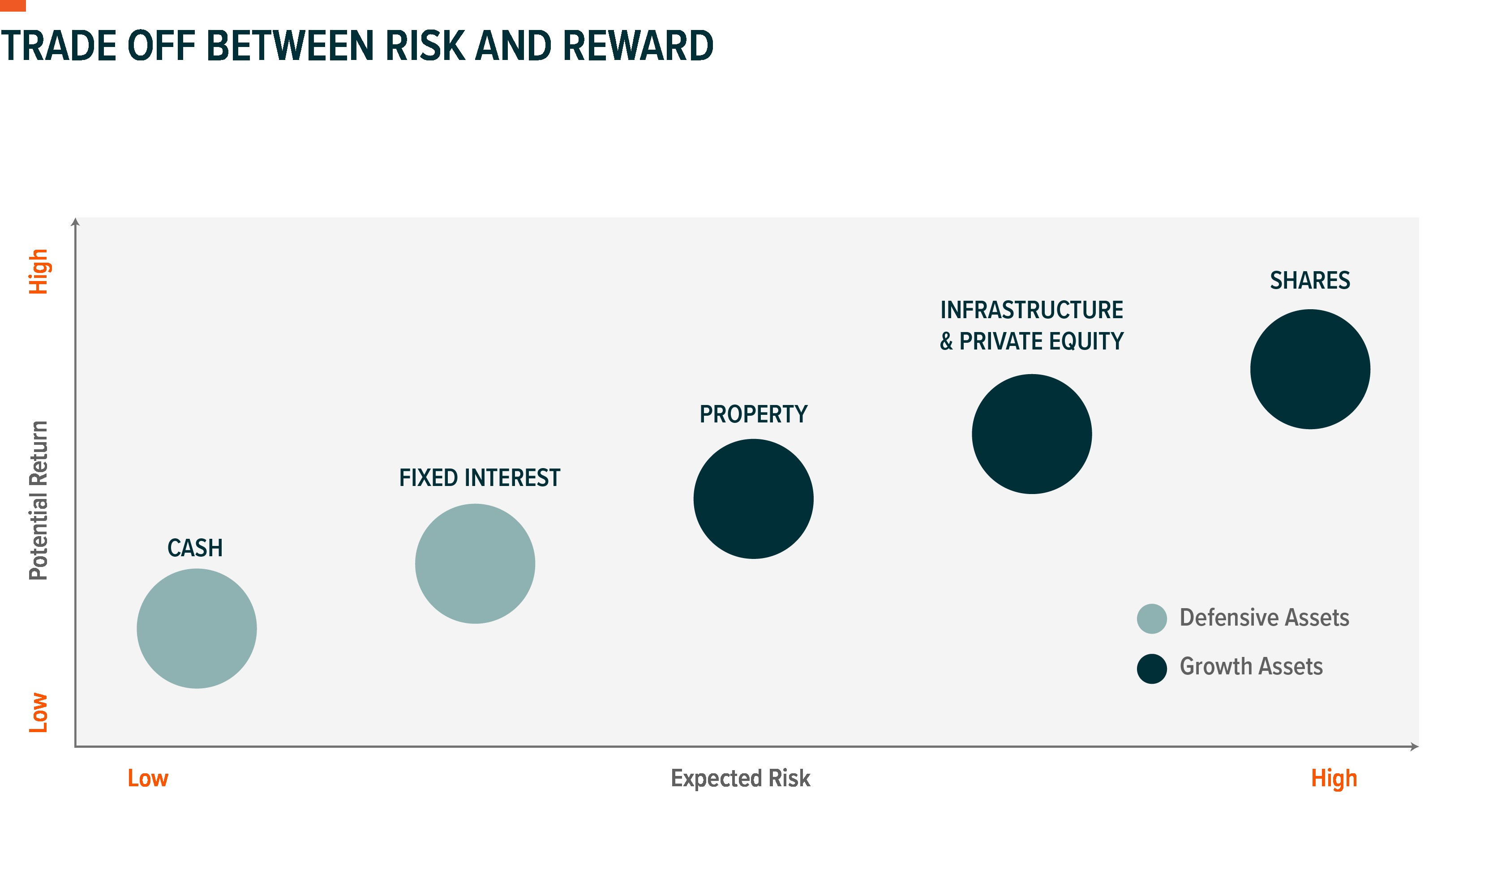
Understanding your risk profile
When building an income-orientated portfolio, the first step should be to get the asset allocation right to ensure the right level of risk is being taken.
Source: Global X theoretical illustration based on historical asset class returns and volatility.

Slide 13
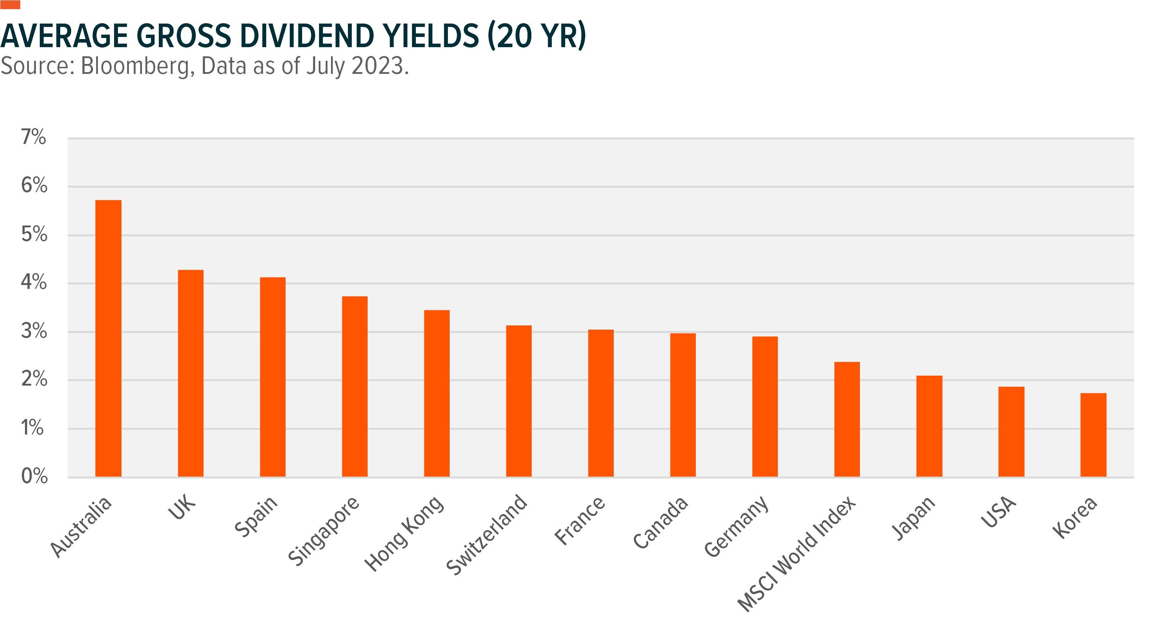
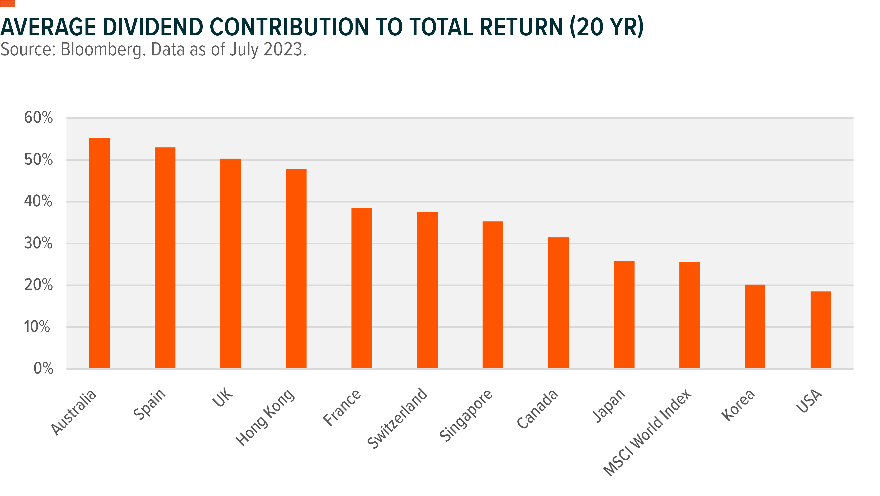
The Lucky Country
Since the turn of the millennium, dividends have accounted for over half of the total return of the Australian share market.

Slide 14
Why taking a “Total Return” approach matters
Most of the largest Australian banks have had negative capital returns. Dividends can add as an important source of returns and help cushion drawdowns.
ASX Code | Company Name | 10-Year Capital Return | 10-Year Dividend return | 10-Year Total Return
MQG | Macquarie Group | 244.7% | 230.8% | 475.6%
CBA | Commonwealth Bank of Australia | 56.1% | 150.7% | 206.8%
NAB | National Australia Bank | 2.3% | 130.9% | 133.2%
BEN | Bendigo & Adelaide Bank | -9.9% | 117.0% | 107.1%
ANZ | ANZ Group Holdings | -10.4% | 106.7% | 96.3%
WBC | Westpac | -24.1% | 89.1% | 65.0%
BOQ | Bank of Queensland | -48.7% | 66.5% | 17.8%
Source: Bloomberg, JP Morgan as of 31 March 2024.

Slide 15
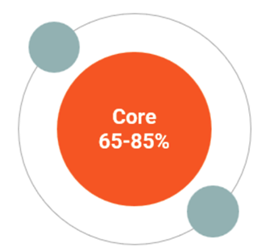
Build a diversified mix of income product assets
ETFs offer diversified asset exposure without selecting individual securities, serving as both core or satellite portfolio components.
Source: Bloomberg as of 31 July 2024. Yield is either dividend yield for equities or yield to maturity for fixed income. Indices used S&P/ASX BuyWrite Index, Solactive Australian Hybrid Securities Index, S&P/ASX 200 High Dividend Index, Solactive USD High Yield Corporates Total Market AUD Hedged Index, Bloomberg USD Liquid Investment Grade Corporate AUD Hedged Index, S&P/ASX 200 Index, S&P/ASX 300 A-REIT Index, Bloomberg Global-Aggregate Index Value Hedged AUD, FTSE Developed Core Infrastructure 50/50 100% Hedged to AUD Index, MSCI World ex Australia AUD Index. Inflation is represented by annualised CPI as of December 2023 from the ABS.

Slide 16
Income Opportunities with ETFs

Slide 17
High Yield Australian Shares
Focusing on high-dividend paying companies whilst avoiding “dividend traps”
Source: Bloomberg data as of 31 July 2024.

Slide 18




ZYAU | Overview
Key Features
Instant Diversification
Simple, low-cost access to a selection of quality dividend investments.
Global X S&P/ASX 200 High Dividend ETF
ASX Code | ZYAU
MER | 0.24%
Benchmark | S&P/ASX 200 High Dividend Index
Rebalance Frequency | Quarterly
Distribution Frequency | Quarterly
12-month yield | 5.6%
Quality Filter
Forward looking dividend forecast captures the highest dividend-paying companies, and the weighting scheme further tilts towards these companies.
High Income Potential
Aims to achieve a yield above the broad market.
Data as of 31 July 2024.

Slide 19
US Bonds
Expanding bond universe to include the world's largest market, with the goal of geographic diversification, potentially capturing additional income, and different interest rate cycles.
Sources: Bloomberg, Global X ETFs as of August 2024. Bank of International Settlements, SIFMA as of 12/31/2022.

Slide 20


USTB | Overview
Key Features
Alternative Income Source
USTB seeks to generate income while mitigating risk.
Global X US Treasury Bond ETF (Currency Hedged)
ASX Code | USTB
MER | 0.19%
Benchmark | iBoxx $ Treasuries Index (AUD Hedged)
Rebalance Frequency | Monthly
Distribution Frequency | Quarterly
Yield to maturity | 3.9%
Duration | 5.9
Credit rating | AAA
Competitive Cost
At a 0.19% management fee, USTB offers access to US Treasuries via the ASX at a competitive cost.
Diversification
Exposure to US Treasuries ranging from 1-30 year maturities.
Data as of 31 July 2024.

Slide 21
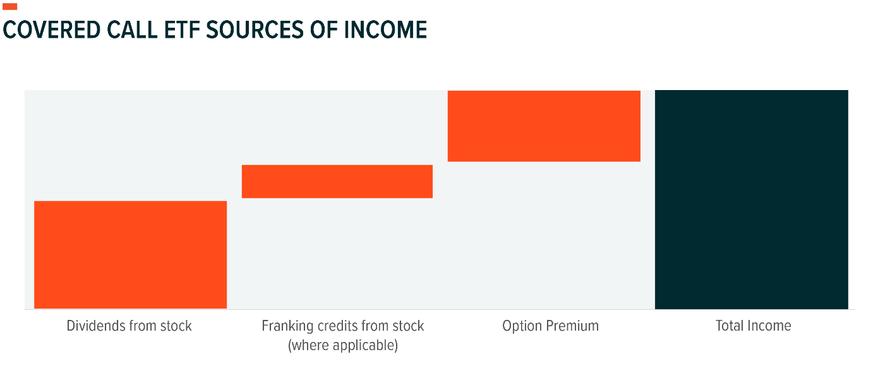
Covered Calls
Combining a basket of shares and writing options aims to diversify income streams and profit during periods of sideways or downward market movements.
Source: S&P Global as of March 2024

Slide 22
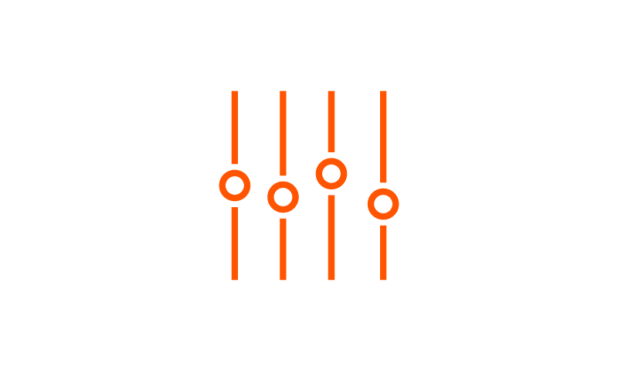
AYLD | Overview
Key Features
High Income Potential
AYLD seeks to generate income through covered call writing which can produce higher yields in periods of volatility.
S&P/ASX 200 Covered Call ETF
ASX Code | AYLD
MER | 0.60%
Benchmark | S&P/ASX 200 BuyWrite Index
Rebalance Frequency | Quarterly
Distribution Frequency | Quarterly
12-month yield | 6.2%
Efficient Options Execution
AYLD writes call options on the S&P/ASX 200 Index, saving investors the time and potential expenses of doing so individually.
Potential Downside Mitigation
The options premiums AYLD generates may partly cushion drawdowns.
Data as of 31 July 2024.

Slide 23
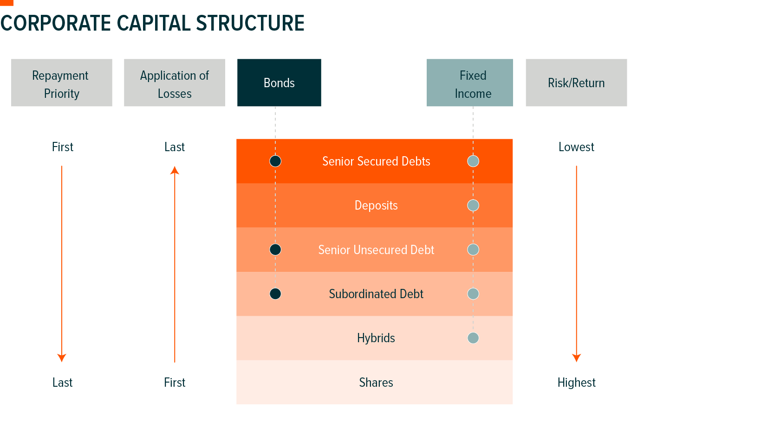
Gaining Access to the Broader Capital Structure of Financial Companies
The Australian bond market is dominated by bonds issued by government and government-related entities. Investors might be missing out on appealing opportunities within the corporate financial sector and accessing broader securities.
Financial Credit Only Comprises <20% of the Total Australian Bond Market
Wide Variety of Securities in the Capital Structure with Higher Priority Than Shares in Liquidation Events
Source: Bloomberg as of 30/06/2024

Slide 24
Fixed Income Masterclass: Bonds are Back
Key Features
BANK | Fund Information
Global X Australian Bank Credit ETF | ETFS FANG+ ETF
ASX Code | BANK
MER | 0.25%
# of Holdings | 134
Distribution Freq. | Monthly
Rebalance Freq. | Monthly
Benchmark Index | Solactive Australian Bank Credit Index
Running Yield | 6%
Attractive Yield
BANK intends to pay monthly income and its index has historically offered higher yields than term deposits, government bonds and corporate bonds.
Convenient and Cost-Effective
A cost-effective package that holds three types of fixed income securities across the banking capital structure (senior bonds, subordinated bonds and hybrid securities) that can be used for income enhancement, capital preservation, and broader diversification.¹
Trusted Source of Income
Australian banks are known for being some of the most credible and robust financial institutions in the world. BANK is the only index-based ETF offering exposure to the broader capital stack of Australia's banks in one diversified solution.
Fixed Income Security | Index Fixed Weighting
Senior Bonds | 40%
Subordinated Bonds | 30%
Hybrids | 30%
Source: Solactive, Bloomberg as of 31 July 2024.
¹ BANK may have some concentration risk as it only holds credit securities issued by Australian banks but is well diversified across the capital structure.

Slide 25
Thank you.

