Slide 1
ACTIVE v PASSIVE ETFs
MADISON INVESTMENT SPECIALIST FORUM
James Harwood
Director, Senior Portfolio Manager

Slide 2
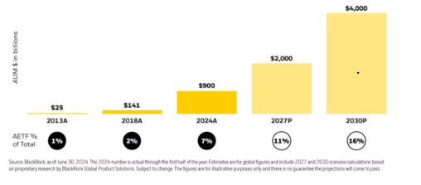
ACTIVE ETFs
In the US BlackRock sees active ETFs quadrupling to $4 trillion by 2030
FOR USE BY FINANCIAL PROFESSIONALS ONLY

Slide 3
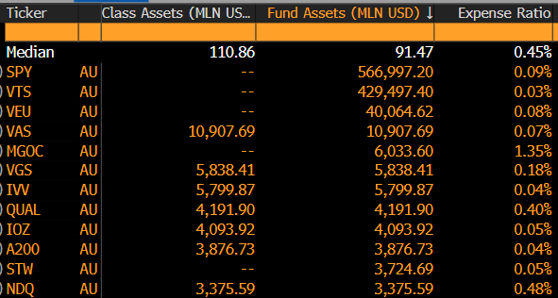
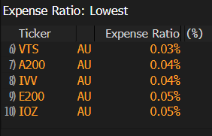
AUSTRALIAN ETF MARKET
What has driven the growth?
Low-cost solutions and easy to access passive products
What you see is what you get (from an index fund)
Daily transparency of underlying holdings (versus lagged holdings for managed funds)
Fund conversions, e.g. Magellan, DFA
Marketing and the tailwind of a growing global industry
Source: Bloomberg
FOR USE BY FINANCIAL PROFESSIONALS ONLY

Slide 4
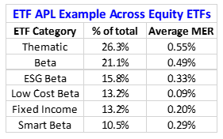
AUSTRALIAN ETF MARKET
Beta v Low-cost beta
Not all passive ETFs are low cost
Fund expenses and index licencing fees drive underlying costs for passive ETFs
Rise of ‘calc agents’ to help drive down costs, and for iNAVs
Continued pricing pressure on more expensive beta products, and active strategies is likely
Combination of passive and active strategies a pragmatic approach
Source: Russell Investments, Bloomberg
FOR USE BY FINANCIAL PROFESSIONALS ONLY

Slide 5
AUSTRALIAN ETF MARKET
Active ETFs
Ability to trade active strategies throughout the day
More timely disclosure of holdings than Managed Funds, but approaches vary and this can affect bid/offer spreads
Bid/offer prices fixed for Managed Funds on platforms but can only trade at the end of the day
The role of Market Makers and Authorised Participants
Internal v external market making
Several ways to structure Active ETFs – stand-alone fund, dual access model or ETF share class (of a managed fund)
FOR USE BY FINANCIAL PROFESSIONALS ONLY

Slide 6
AUSTRALIAN ETF MARKET
Active ETFs – recent launches
Variety of approaches taken to structure Active ETFs
Fundamental active and active quant investment styles
Pricing structures vary greatly
AUM yet to take off but Active ETFs are still a relatively new concept for the Australian market
FOR USE BY FINANCIAL PROFESSIONALS ONLY

Slide 7
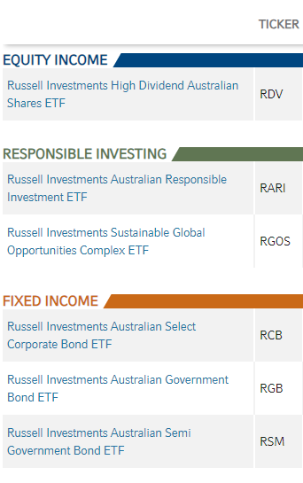
RUSSELL INVESTMENTS ETFS
Innovating since 2010
Russell launched ETFs in Australia in 2010 with the listing of RDV, a smart beta equity income ETF
3 complementary passive Australian bond ETFs
Active and smart beta responsible investment solutions in global and Australian equities
Our ETFs are used as solutions within our Managed Accounts - combining passive and active strategies to offer attractive multi-asset solutions
FOR USE BY FINANCIAL PROFESSIONALS ONLY

Slide 8
RGOS / An institutional grade active ESG solution
RUSSELL INVESTMENTS SUSTAINABLE GLOBAL OPPORTUNITIES COMPLEX ETF
As a core ESG global equity allocation | To provide active exposure to ESG
RGOS can be considered as part of a core international shares allocation in a balanced portfolio, providing geographical diversification and ESG benefits in one go. | RGOS uses complementary managers to balance factors such as growth, quality, and value to provide less volatile performance patterns, while still pursuing excess returns above RGOS’ global equity benchmark.
Portfolio allocation:
Core global equity allocation
Benchmark: MSCI ACWI Index- Net
Distribution frequency:
Quarterly
Management fee:
0.95% p.a.
Minimum investment timeframe: 7 years
The Target Market Determination for the Fund is available on our website at www.russellinvestments.com/au/support/tmds.
Notes:
RGOS is designed as a core ESG global equity allocation. It also provide those investors who can’t tolerate large performance swings, typical of single manager ESG solutions, active exposure to ESG.
RGOS benefits from:
Deliberate security selection: RGOS caters to investors who are committed to Environmental, Social, and Governance (ESG) principles. Increasingly, investors who are looking to invest responsibly are requiring every inclusion and exclusion in their portfolio to be thoughtfully considered. Active management looks further than just the numbers, conducting in-depth research into securities and ensuring that every selection aligns with a deliberate process and philosophy. Furthermore, active engagement with the companies invested in ensures transparency and impact.
Challenges of passive management: In a rapidly evolving ESG environment, tomorrow’s ESG leaders may not fit neatly into yesterday’s quant-based rules. RGOS addresses this by embracing active management.
Potential for outperformance: This active management provides the potential for outperformance and excess returns compared to the benchmark.
Suitable for investors seeking international equity-like returns with a long-term investment horizon, and a readiness to tolerate some currency and emerging market risks.
Investors must also be willing to accept the possibility of negative returns over the short to medium term.

Slide 9
RGOS / Complementary managers
THE MULTI-STRATEGY SOLUTION
Manager^ | Role in the portfolio | Strategy | Sustainability focus*
 | Relative value | Ethical Global Value | Focus is on engagement and stewardship with companies who Sparinvest consider are making progress towards developing better ESG credentials in areas such as human rights, the environment, labour standards, and anti-corruption.
 | Stable quality | Global Stewards | Focus is on improving companies' environmental, social or governance practices by engaging directly with the company to improve its business practices.
 | Quality growth | Global Sustainable Equity | Focus is on companies with environmentally friendly business models that Neuberger Berman considers operate in non-harmful industries and which they consider may benefit from a transition to a more sustainable global economy.
 | Quality growth | Global Sustainable Equity | Focus is on companies that Mirova considers offer positive solutions to social or environmental challenges, such as financial inclusion, clean technology, or disaster recovery and which may benefit from long term changes in demographics, technology, the environment, and governance.
 | Global value/ Low volatility | Active positioning | Focus is on a quantitative driven approach using data to tilt positively to environmental themes.
^Investment managers may change at any time without notice. The number of managers included in the fund may change depending on the suitability. *Please refer to the RGOS PDS for further information on the Sustainable Strategies.
Notes:
Combining complementary styles: RGOS takes a unique approach. It thoughtfully combines multiple active ESG managers, each with complementary styles. We are very focused on ensuring a balanced approach in the construction. Because many ESG managers lean toward growth-oriented strategies (there is an inherent bias), RGOS also includes a value-style ESG manager—typically hard to find or access. This typical bias towards growth-oriented strategies have suffered in the current market environment, so the manager diversification of RGOS helps to manage risk, while maintaining potential for excess returns.
• Our aim is to construct a balanced portfolio, where stock specific risk (manager’s stock picking – the most sustainable alpha source) is the key contributor to active risk, while systematic and timing risks are minimised (style, regions).
• Diversification is a key component to the portfolio construction process to achieve balance. To create a balanced portfolio (neutral style profile, stock specific is the dominant risk) we need both growth and value managers in a portfolio. Fewer managers offer less diversification.
• As one of the few Value managers available we keep Sparinvest at a higher weight to balance the other growth strategies

Slide 10
Important information and disclosures
Issued by Russell Investment Management Ltd ABN 53 068 338 974, AFS Licence 247185 (RIM). This document provides general information for financial advisers who are AFS licence holders or representatives only. It must not be passed on to any retail client. This document contains factual information only. The information provided is not intended to imply any recommendation or opinion about a financial product. RIM is not providing financial product advice in this document. This document has not been prepared having regard to any investor’s objectives, financial situation or needs. Before making an investment decision, an investor must obtain advice from a financial adviser and consider whether that advice is appropriate to their objectives, financial situation or needs. This information has been compiled from sources considered to be reliable but is not guaranteed. Past performance is not a reliable indicator of future performance.
Please contact your platform operator(s) for performance or current holdings in the Managed Portfolios.
Unless stated otherwise, the Estimated Fee in this document excludes GST, as GST is charged differently across different platforms. It consists of an estimated model fee and the actual costs of the underlying investments in the model portfolio, including known performance fees of underlying funds where applicable, sourced from their PDS or other public sources. The estimated model fee excludes GST and consists of fees charged by the platform to investors based on their investment in the portfolio, a portion of which is shared with Russell Investments as investment adviser. The underlying investment fee is the cost of the underlying investments in the model portfolio and is calculated based on the strategic asset allocation weightings and the published underlying fees of the underlying investments as of month March 2023 and can be expected to change over time as asset allocations and underlying investment vehicles change. It excludes transaction costs. This Estimated Fee is not the full cost of investment as it does not include certain other costs, such as transaction costs (e.g. brokerage or bid ask spreads) that investors incur or any other costs charged by platforms.
Any potential investor should also consider the latest product disclosure statement in respect of the Managed Portfolio or RIM Fund (‘‘Disclosure Document’’) in deciding whether to make, or continue to hold, any investment. The Disclosure Document for the Managed Portfolio can be obtained by contacting a financial adviser or the relevant platform operator(s). The Disclosure Document for the RIM Funds can be obtained by visiting www.russellinvestments.com.au or by phoning (02) 9229 5111. The Target Market Determinations for the RIM Funds are available on our website at wwwrussellinvestments.com/au/support/tmds.
RIM is part of Russell Investments. RIM is the issuer of the RIM Funds and RIM ETFs mentioned in this document. Russell Investments or its associates, officers or employees may have interests in the financial products referred to in this information by acting in various roles including broker or adviser, and may receive fees, brokerage or commissions for acting in these capacities. In addition, Russell Investments or its associates, officers or employees may buy or sell the financial products as principal or agent.
To the extent permitted by law, no liability is accepted for any loss or damage as a result of reliance on this information. This material does not constitute professional advice or opinion and is not intended to be used as the basis for making an investment decision. This work is copyright 2023. Apart from any use permitted under the Copyright Act 1968, no part may be reproduced by any process, nor may any other exclusive right be exercised, without the permission of Russell Investment Management Ltd. [AUSF2-01682 09/2023]
FOR USE BY FINANCIAL PROFESSIONALS ONLY

